Slide 1

Routing and Architecture
Browser Routing Design Patterns in JS
SoftUni Team
Technical Trainers
Software University
http://softuni.bg

Slide 2
Table of Content
Routing Concepts
Navigation and History
Sammy.js Overview

Slide 3
Have a Question?
sli.do
#JS-CORE

Slide 4
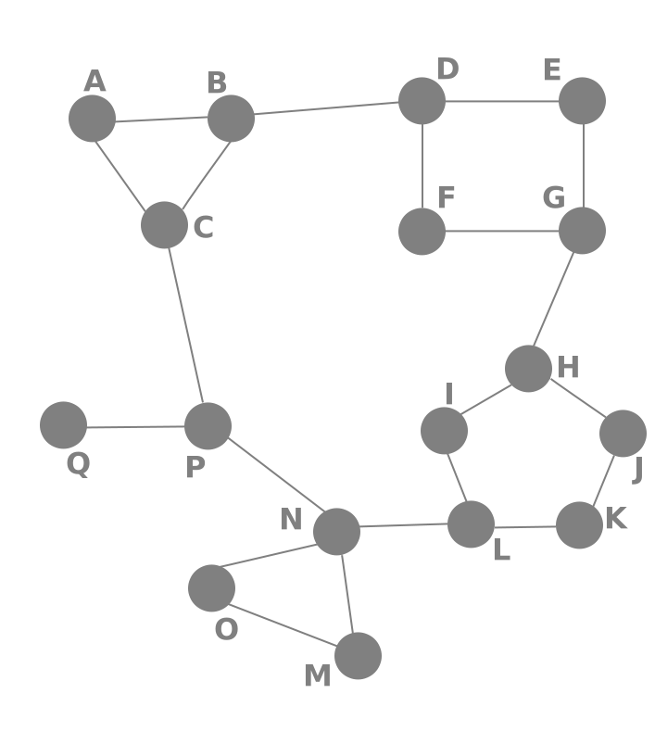
Routing Concepts
Navigation for Single Page Applications

Slide 5


What is Routing?
Allows navigation, without reloading the page
Pivotal element of writing Single Page Applications
HTML
HTML
HTML
Link
HTML
HTML
ROUTER
Link
HTML
HTML
HTML
HTML
Link
Standard Navigation
Navigation using Routing

Slide 6
Single-page applications (SPA)
One web page that you visit which then loads all other content using JavaScript
Does not require page reloading during use
Request just the peace you need
Take advantage of the repetition
Can use state from an external source or track state internally

Slide 7
How Routers Work
A Router loads the appropriate content when the location changes
E.g. when the user manually enters an address
Conversely, a change in content is reflected in the address bar
E.g. when the user clicks on a link
Benefits:
Load all scripts only once
Maintain state across multiple pages
Browser history can be used
Build User Interfaces that react quickly

Slide 8




How Routers Work
Hash-based routing
Using the #hash part of the URL to simulate different content
The routing is possible because changes in the hash don't trigger page reload

Slide 9
How Routers Work (2)
var url = null;
var getCurrent = function () {
return window.location.hash;
};
var listen = function () {
var current = getCurrent();
if (current !== url) {
console.log('URL changed to' + current);
url = current;
}
setTimeout(listen, 200);
};
Listen();

Slide 10
The pushState() method
pushState() takes three parameters: a state object, a title and a URL
State - object which is associated with the new history entry
Title - browsers currently ignore this parameter
URL - The new history entry's URL is given by this parameter

Slide 11
The replaceState() method
history.replaceState() - modifies the current history entry instead of creating a new one
It is useful when you want to update the state object or URL
var stateObj = { facNum: "56789123" };
history.pushState(stateObj, "", "student.html");
history.replaceState(stateObj, "", "newStudent.html");

Slide 12
The popstate event
A popstate event is dispatched to the window every time the active history entry changes
If the history entry being activated:
was created by a call to pushState
affected by a call to replaceState
The popstate event's state property contains a copy of the history entry’s state object

Slide 13

Live Demo

Slide 14

Routing with Sammy.js
Overview and Examples

Slide 15
Sammy.js Overview
Sammy is a lightweight routing library
Modular design with plugins and adapters
Requires jQuery
Many additional features
const app = Sammy('#main', function() {
this.get('#/index.html', () => {
this.swap('Index');
})
});

Slide 16
Installation
Download Sammy, by using WebStorm's terminal
Or download from sammyjs.org
Browser builds will be located in:
It's best if your project has a package.json file
npm install --save sammy
node_modules/sammy/lib/

Slide 17
Application Initialization
Create a Sammy instance to initialize your application
You may have multiple apps running
Each selector can only hold one app
If you refer to it again, it extends the functionality
Invoke library
Element selector
const app = Sammy('#main', function () {
// Define routes and other logic here
});
$(() => app.run()); // Activate

Slide 18
Creating Routes
The main building block of Sammy is the route
Defined by method and address (URI)
Place this block inside a Sammy initializer:
A note on using this: it holds a reference to the router object, but may not work correctly in an arrow function
Route Method
Route address
this.route('get', '#/about', function() {
this.swap('<h2>Contact Page</h2>');
});

Slide 19
Route Aliases
Each method has an alias for shorter code
this.get('#/catalog', loadBooks);
this.post('#/login', userLogin);
this.put('#/catalog/:bookId', updateBook);
this.del('#/catalog/:bookId', deleteBook);

Slide 20
URL Parameters
Parameters allow for dynamic routes
E.g. products in a catalog will load the same page
You can get the whole path using this.path
Parameter name
Receive context
this.get('#/catalog/:productId', (context) => {
console.log(context.params.productId);
});
Access passed in value

Slide 21
Hello Sammy
index.html
<!DOCTYPE html>
<head>
<meta charset="UTF-8">
<title>Hello Sammy</title>
<!-- Include jQuery and Sammy distributions -->
</head>
<body>
<header>
<h1>Hello Sammy</h1>
<a href="#/index.html">Home</a>
<a href="#/about">About</a>
<a href="#/contact">Contact</a>
</header>
<div id="main"></div>
</body>
</html>

Slide 22
Hello Sammy (2)
app.js
const app = Sammy('#main', function () {
this.get('#/index.html', () => {
this.swap('<h2>Home Page</h2>');
});
this.get('#/about', () => {
this.swap('<h2>About Page</h2>');
});
this.get('#/contact', () => {
this.swap('<h2>Contact Page</h2>');
});
});
$(() => {
app.run();
});

Slide 23
Handling Forms
Forms inside the main element are automatically handled
Route address
Route method
<form action="#/login" method="post">
User: <input name="user" type="text">
Pass: <input name="pass" type="password">
<input type="submit" value="Login">
</form>
Names of inputs
this.post('#/login', (context) => {
console.log(context.params.user);
console.log(context.params.pass);
});

Slide 24
Integrating Handlebars
Download and include the Handlebars source in your HTML
Include sammy.handlebars.js (found under lib/plugins)
Load the plugin inside a Sammy initializer:
Create a RenderContext with render, load or partial
this.use('Handlebars', 'hbs');
Template file extension

Slide 25
Using Handlebars
greeting.hbs
<h1>{{title}}</h1>
<p>Hello, {{name}}!</p>
app.js
const app = Sammy('#main', function () {
this.use('Handlebars', 'hbs');
this.get('#/hello/:name', function() {
this.title = 'Hello!'
this.name = this.params.name;
this.partial('greeting.hbs');
});
});
$(() => app.run());
Load and swap in the template

Slide 26
Using Handlebars
Load a list of partial templates (inside a route definition):
The callback will be executed once all partials are loaded
Templates are cached - there's no need to manually cache them
this.loadPartials({
firstPartial: 'path-to/first.hbs',
secondPartial: 'path-to/second.hbs',
thirdPartial: 'path-to/third.hbs'
}).then(function(context) => {
console.log(context.partials);
this.partial('pageTemplate.hbs');
});

Slide 27
Additional Features
Redirect
Custom events
Useful plugins (found under lib/plugins):
Storage and Session
OAuth2
this.redirect('#/other/route');
this.redirect('#', 'other', 'route');
// Register event handler
this.bind('event-name', eventHandlerFunction);
// Raise event
this.trigger('event-name', data);

Slide 28

Routing with Sammy.js
Overview and Examples

Slide 29
What are Design Patterns
Design Patterns are general approaches to solving commonly occurring problems
They provide:
Tested, proven programming paradigms
Guidelines to organizing our code
A common vocabulary between developers
Using a pattern may increase complexity - misuse often creates more problems than it solves

Slide 30
Splitting Your Code
Splitting your code aims to separation of concerns (only change the parts that need to be changed)
Sample code organization
Main script
Requester (Remote API)
Authenticator
Router
View Controllers

Slide 31
Live Exercise

Slide 32

Summary
Browser Routing allows SPAs to use history
Sammy.js is a simple routing library
Modular code is more maintainable
…
…
…
const app = Sammy('#main', function () {
this.get('index.html', () => {
this.swap('<h1>Index Page</h1>');
})
});

Slide 33
https://softuni.bg/courses/js-apps

Slide 34













SoftUni Diamond Partners

Slide 35




SoftUni Organizational Partners

Slide 36




Trainings @ Software University (SoftUni)
Software University – High-Quality Education and Employment Opportunities
softuni.bg
Software University Foundation
http://softuni.foundation/
Software University @ Facebook
facebook.com/SoftwareUniversity
Software University Forums
forum.softuni.bg

Slide 37

License
This course (slides, examples, demos, videos, homework, etc.) is licensed under the "Creative Commons Attribution-NonCommercial-ShareAlike 4.0 International" license

